Slide 1
Randomized Algorithms CS648
Lecture 22
Probabilistic Method – II
Derandomization

Slide 2
Probabilistic methods

Slide 3
Probabilistic methods
Methods that use
Probability theory or
Randomized algorithm
to prove deterministic combinatorial results

Slide 4
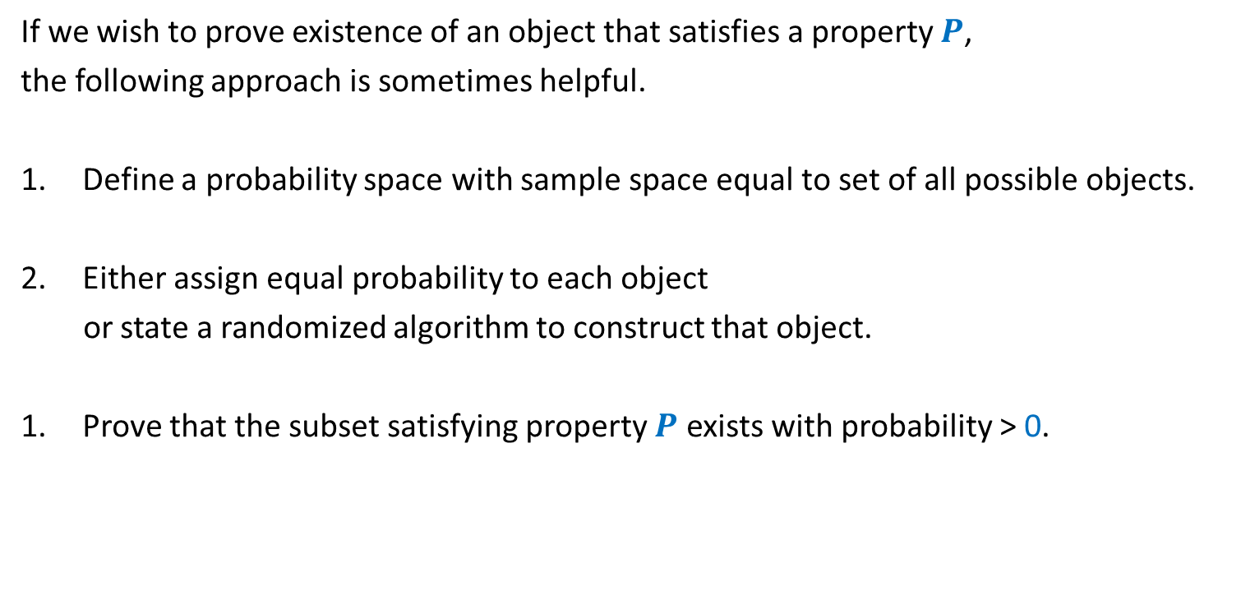
A common framework of using Probabilistic methods
If we wish to prove existence of an object that satisfies a property $P$,
the following approach is sometimes helpful.
Define a probability space with sample space equal to set of all possible objects.
Either assign equal probability to each object
or state a randomized algorithm to construct that object.
Prove that the subset satisfying property $P$ exists with probability > 0.

Slide 5







Questions from Discrete Mathematics
Question: (Geometry)
There is a set $P$of $100$points in plane and no three of them are collinear.
What can be the max. no. of acute triangles formed by these points ?
Theorem: (Large-cut)
Every graph on $n$vertices and $m$ edges has a cut of size $≥$ …..
At most $70\%$
Property:
Triangle is acute angle.
Sample space =
Set of all possible triangles formed by points from $P$.
Each triangle is equally likely to be picked.
We showed that a randomly picked triangle is acute angle triangle with probability $≤$ 0.7
We shall now demonstrate the use of this framework with a new problem ☺.
$$m/2$$
Property:
Cut of size $≥m/2$.
Sample space =
Set of all cuts (including cut defined by all vertices)
We gave a randomized algorithm to pick a cut.
We showed that expected size of the cut will be $≥m/2$

Slide 6
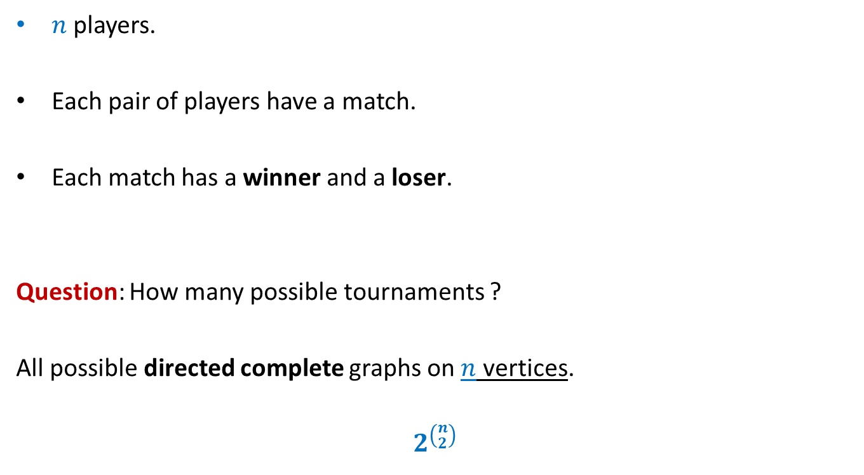
A tournament
$n$ players.
Each pair of players have a match.
Each match has a winner and a loser.
Question: How many possible tournaments ?
All possible directed complete graphs on $n$ vertices.
$$2^{\left({n \atop 2}\right)}$$

Slide 7




Problem 4
Problem: Let $k$ be any positive integer.
Prove that if
for each subset of $k$ players, there is a player who defeats them all.
Let us use the framework described just now to solve this problem.
It suffices if we can show the following:
$$\left({n \atop k}\right){\left(1−2^{−k}\right)}^{n−k}<1$$
, then there exists a tournament of $n$players s.t.
Property $D_{k}$
Sample space =
Set of all possible tournaments
Size of the set = $2^{\left({n \atop 2}\right)}$
Each tournament is equally likely.
A randomly picked tournament is not going to satisfy property $D_{k}$ with probability< $1$
We shall now establish this inequality systematically.

Slide 8










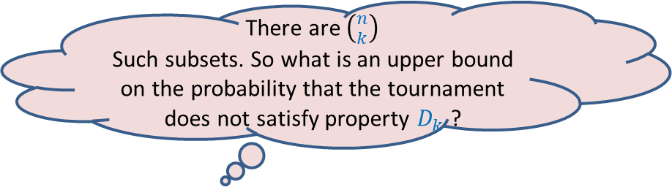
Problem 4
Problem: Let $k$ be any positive integer.
Prove that if
for each subset of $k$ players, there is a player who defeats them all.
$$\left({n \atop k}\right){\left(1−2^{−k}\right)}^{n−k}<1$$
, then there exists a tournament such that
Property $D_{k}$
Sample space =
Set of all possible tournaments
Size of the set = $2^{\left({n \atop 2}\right)}$
Each tournament is equally likely.
There are $\left({n \atop k}\right)$
Such subsets. So what is an upper bound on the probability that the tournament does not satisfy property $D_{k}$ ?
What is the probability that this player does not defeat all players of the set ?
What is the probability that this player defeats all players of the set ?
What is the probability that no player outside the set defeats all players of the set ?
Consider any player outside this set.
Consider any subset of $k$ players.
$$n−k$$
$$\left({n \atop k}\right)$$
$$2^{−k}$$
$$\left(1−2^{−k}\right)$$
$$<1$$
We are done ☺
$$k$$
Hint: Use Union theorem
$$n$$

Slide 9
problem 5 Sum free subset of large size

Slide 10


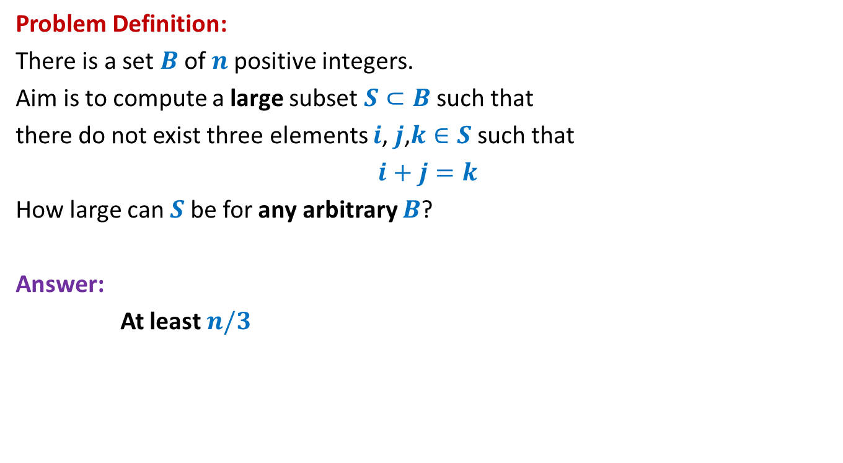



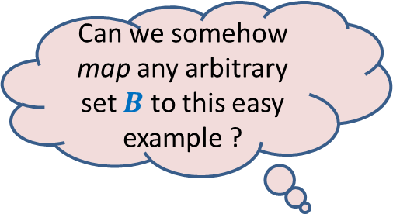
Large subset that is sum-free
Can we somehow map any arbitrary set $B$ to this easy example ?
Problem Definition:
There is a set $B$of $n$positive integers.
Aim is to compute a large subset $S⊂B$such that
there do not exist three elements $i$, $j$,$k∈S$ such that
$i+j=k$
How large can $S$be for any arbitrary $B$?
Answer:
At least $n/3$
Yes, by randomization
An easy example of $B$
Suppose $B=[1..n]$
$$n=3m$$
$m m+1$ … … $2m+1$
$1 2$ … … $3m$
$$S$$

Slide 11

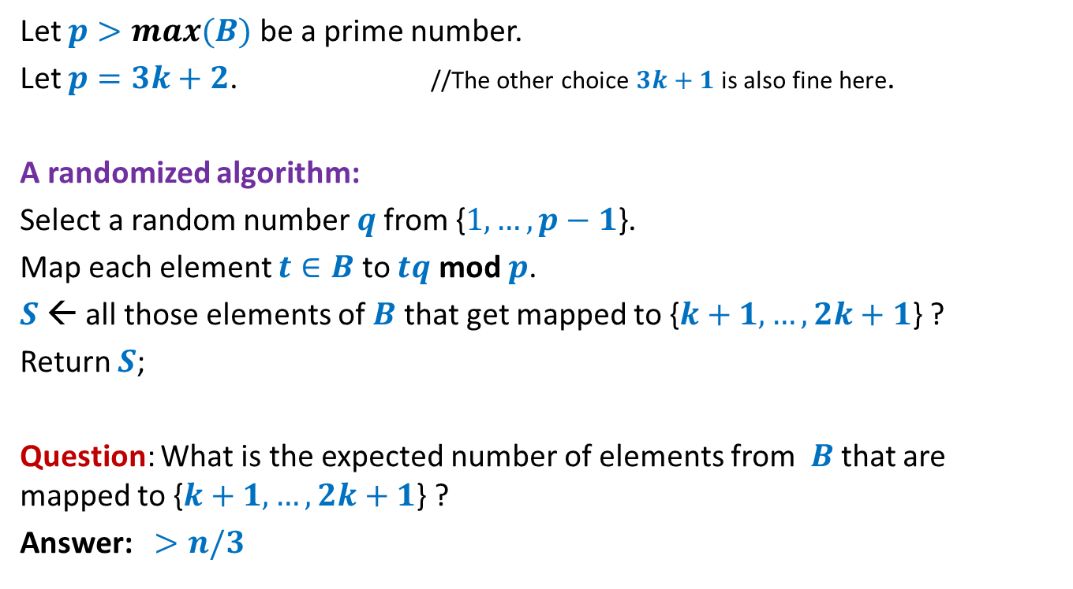
Large subset that is sum-free
Let $p>max(B)$ be a prime number.
Let $p=3k+2$. //The other choice $3k+1$ is also fine here.
A randomized algorithm:
Select a random number $q$from {$1,…,p−1$}.
Map each element $t∈B$ to $tq$ mod $p$.
$S$← all those elements of $B$ that get mapped to {$k+1,…,2k+1$} ?
Return $S$;
Question: What is the expected number of elements from $B$that are mapped to {$k+1,…,2k+1$} ?
Answer: $>n/3$
Homework 1
Homework 2
Show that $S$ is sum-free.

Slide 12
Random bit complexity
Definition : The total number of random bits taken from the Random Bit Generator by the algorithm is called its Random bit complexity.
Input
A Randomized Algorithm
(Min-Cut, QuickSort, RIC,…)
Random Bit generator

Slide 13
Recall the notion of independence

Slide 14

Types of independences
Definition: $ε_{1},…,ε_{n}$ are said to be mutually independent if
$P\left(\bigcap_{i}{ε_{i}}\right)=\prod_{i}{P(ε_{i})}$
Definition: $ε_{1},…,ε_{n}$ are said to be pairwise independent if
for every $1≤i<j≤n$
$P\left(ε_{i}∩ε_{j}\right)=P(ε_{i})$∙ $P(ε_{j})$

Slide 15
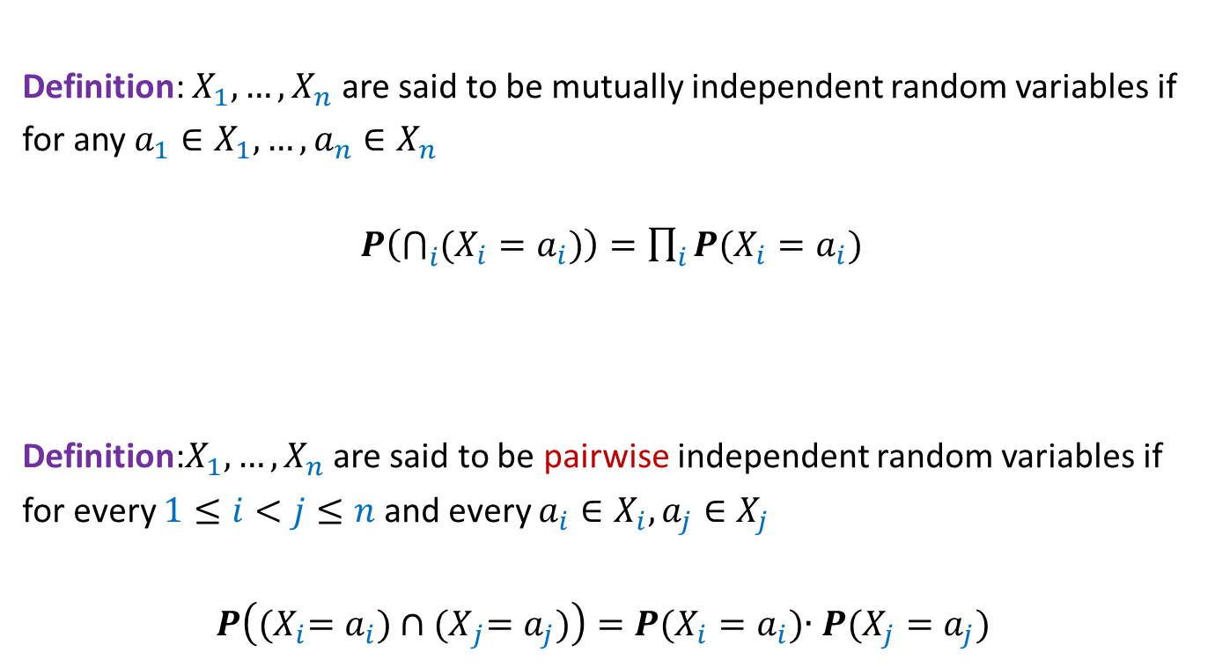
Types of independences
Definition: $X_{1},…,X_{n}$ are said to be mutually independent random variables if
for any $a_{1}∈X_{1},…,a_{n}∈X_{n}$
$P\left(\bigcap_{i}{(X_{i}=a_{i})}\right)=\prod_{i}{P(X_{i}=a_{i})}$
Definition:$X_{1},…,X_{n}$ are said to be pairwise independent random variables if
for every $1≤i<j≤n$ and every $a_{i}∈X_{i},a_{j}∈X_{j}$
$P\left({(X}_{i}=a_{i})∩{(X}_{j}=a_{j})\right)=P(X_{i}=a_{i})$∙ $P(X_{j}=a_{j})$

Slide 16
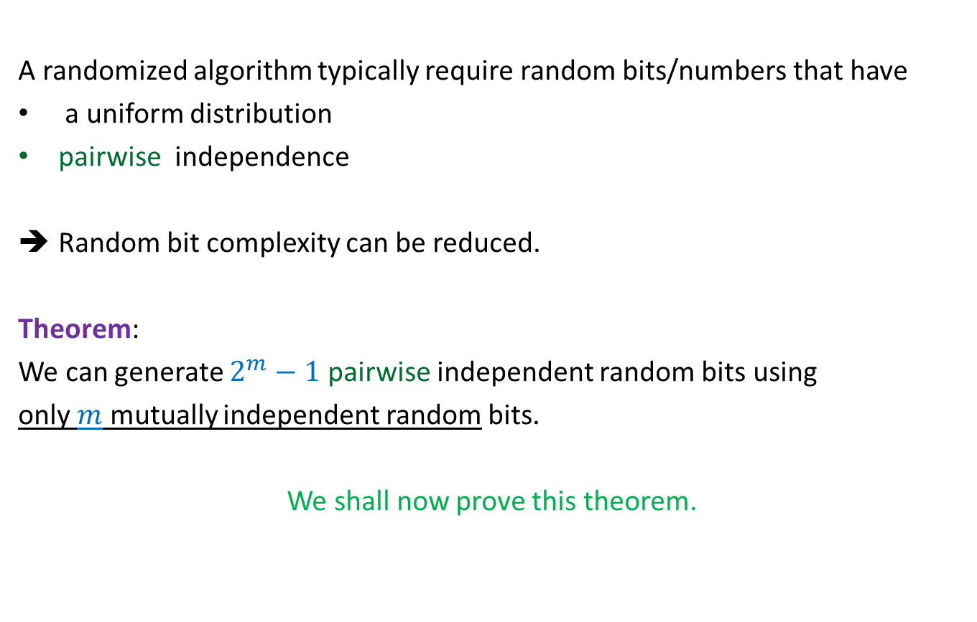
Important facts
A randomized algorithm typically require random bits/numbers that have
a uniform distribution
pairwise independence
Random bit complexity can be reduced.
Theorem:
We can generate $2^{m}−1$ pairwise independent random bits using
only $m$ mutually independent random bits.
We shall now prove this theorem.

Slide 17
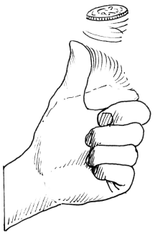

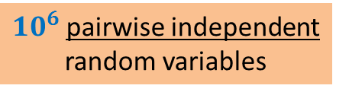

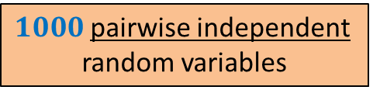
$1000$pairwise independent
random variables
$10^{6}$pairwise independent
random variables
$10$ tosses of a fair coin
$20$tosses of a fair coin

Slide 18
Generating Uniformly Random and pairwise independent Bits
using few truly random bits

Slide 19

















Generating Uniformly Random and pairwise independent Bits
Let $X_{0},…,X_{m−1}$ be $m$ mutually independent random bits.
Aim: To generate $2^{m}−1$ pairwise independent random bits $\{Y_{i}\}$
Key idea: Generate all non-empty subsets of {$X_{0},…,X_{m−1}$}
Ex:$m=3$
Why the XOR operation $⊕$ ? You should get its answer yourself after a few slides…
2 1 0
0 | 0 | 0
0 | 0 | 1
0 | 1 | 0
0 | 1 | 1
1 | 0 | 0
1 | 0 | 1
1 | 1 | 0
1 | 1 | 1
{ $X_{0}$ }
$$Y_{1}$$
$$Y_{2}$$
$$Y_{3}$$
$$Y_{4}$$
$$Y_{5}$$
$$Y_{6}$$
$$Y_{7}$$
$$X_{0}$$
{ $X_{1}$ }
$$X_{1}$$
{ ${X_{1},X}_{0}$ }
$$X_{1}⊕X_{0}$$
{ $X_{2}$ }
$$X_{2}$$
{ $X_{2}$, $X_{0}$ }
$$X_{2}⊕X_{0}$$
{ $X_{2}$, $X_{1}$ }
$$X_{2}⊕X_{1}$$
{ $X_{2}$, $X_{1}$, $X_{0}$ }
$$X_{2}⊕X_{1}⊕X_{0}$$

Slide 20
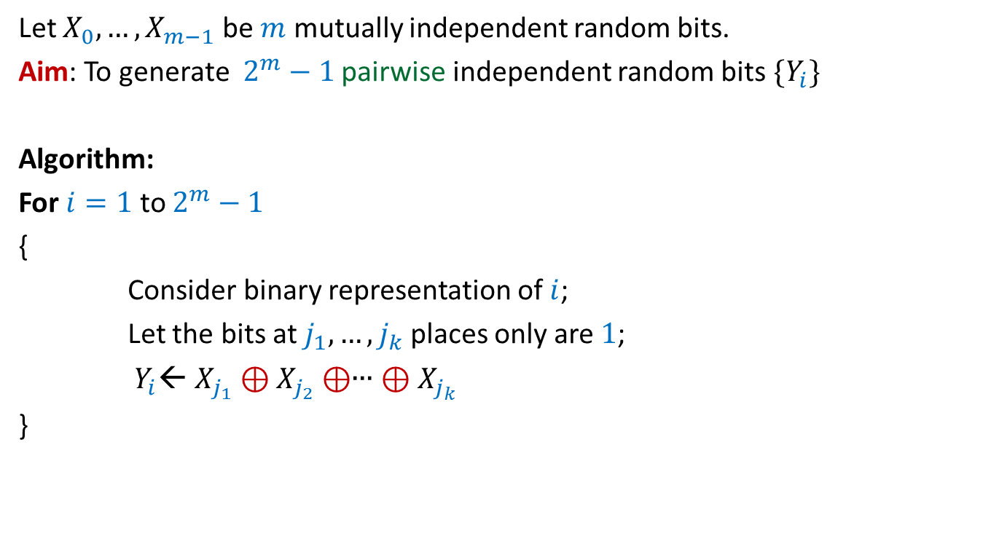
Generating Uniformly Random and pairwise independent Bits
Let $X_{0},…,X_{m−1}$ be $m$ mutually independent random bits.
Aim: To generate $2^{m}−1$ pairwise independent random bits $\{Y_{i}\}$
Algorithm:
For $i=1$ to $2^{m}−1$
{
Consider binary representation of $i$;
Let the bits at $j_{1},…,j_{k}$ places only are $1$;
$Y_{i}$← $X_{j_{1}}⊕X_{j_{2}}⊕$∙∙∙ $⊕X_{j_{k}}$
}

Slide 21
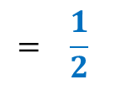
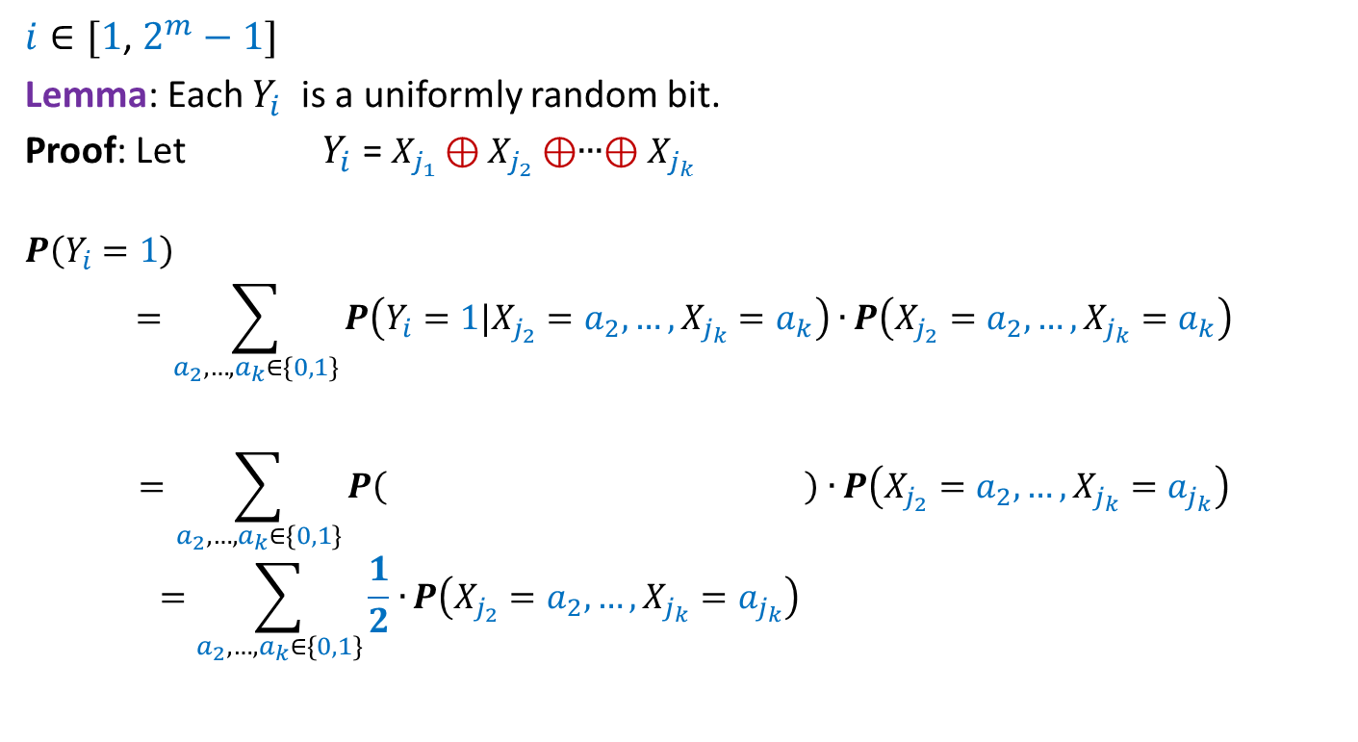

Generating Uniformly Random and pairwise independent Bits
$i∈[1$, $2^{m}−1]$
Lemma: Each $Y_{i}$ is a uniformly random bit.
Proof: Let $Y_{i}$ = $X_{j_{1}}⊕X_{j_{2}}⊕$∙∙∙$⊕X_{j_{k}}$
$$P\left(Y_{i}=1\right)$$
$$=\sum_{a_{2},…,a_{k}∈\{0,1\}}{P\left(Y_{i}=1|X_{j_{2}}=a_{2},…,X_{j_{k}}=a_{k}\right)∙}P\left(X_{j_{2}}=a_{2},…,X_{j_{k}}=a_{k}\right)$$
$$=\sum_{a_{2},…,a_{k}∈\{0,1\}}{P\left( \right)∙}P\left(X_{j_{2}}=a_{2},…,X_{j_{k}}=a_{j_{k}}\right)$$
$$=\sum_{a_{2},…,a_{k}∈\{0,1\}}{\frac{1}{2}∙}P\left(X_{j_{2}}=a_{2},…,X_{j_{k}}=a_{j_{k}}\right)$$
$$X_{j_{1}}⊕a_{2}⊕\text{∙∙∙}⊕a_{k}=1$$
$$= \frac{1}{2}$$

Slide 22

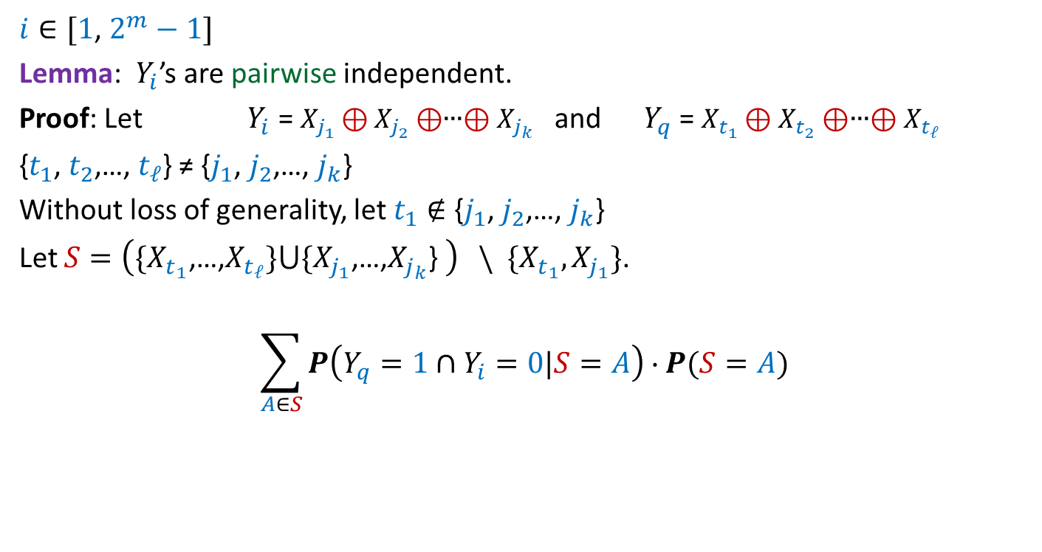

Generating Uniformly Random and pairwise independent Bits
$i∈[1$, $2^{m}−1]$
Lemma: $Y_{i}$’s are pairwise independent.
Proof: Let $Y_{i}$ = $X_{j_{1}}⊕X_{j_{2}}⊕$∙∙∙$⊕X_{j_{k}}$ and $Y_{q}$ = $X_{t_{1}}⊕X_{t_{2}}⊕$∙∙∙$⊕X_{t_{ℓ}}$
{$t_{1}$, $t_{2}$,…, $t_{ℓ}$} ≠ {$j_{1}$, $j_{2}$,…, $j_{k}$}
Without loss of generality, let $t_{1}∉$ {$j_{1}$, $j_{2}$,…, $j_{k}$}
Let $S=\left(\{X_{t_{1}}\text{,…,}X_{t_{ℓ}}\}⋃\{X_{j_{1}}\text{,…,}X_{j_{k}}\text{\} }\right) \backslash \{X_{t_{1}},X_{j_{1}}\}$.
$$\sum_{A∈S}{P\left(Y_{q}=1∩Y_{i}=0|S=A\right)}∙P(S=A)$$
$$P\left(Y_{q}=1∩Y_{i}=0\right)=$$
$$=\frac{1}{4}$$
Homework 3

Slide 23
derandomization
a randomized algorithm ➔ a deterministic algorithm

Slide 24

Large cut in a graph
Theorem: (Probabilistic Methods - I)
Let $G$be an undirected graph on $n$vertices and $m$ edges.
There exists a cut of size at least $m/2$.

Slide 25
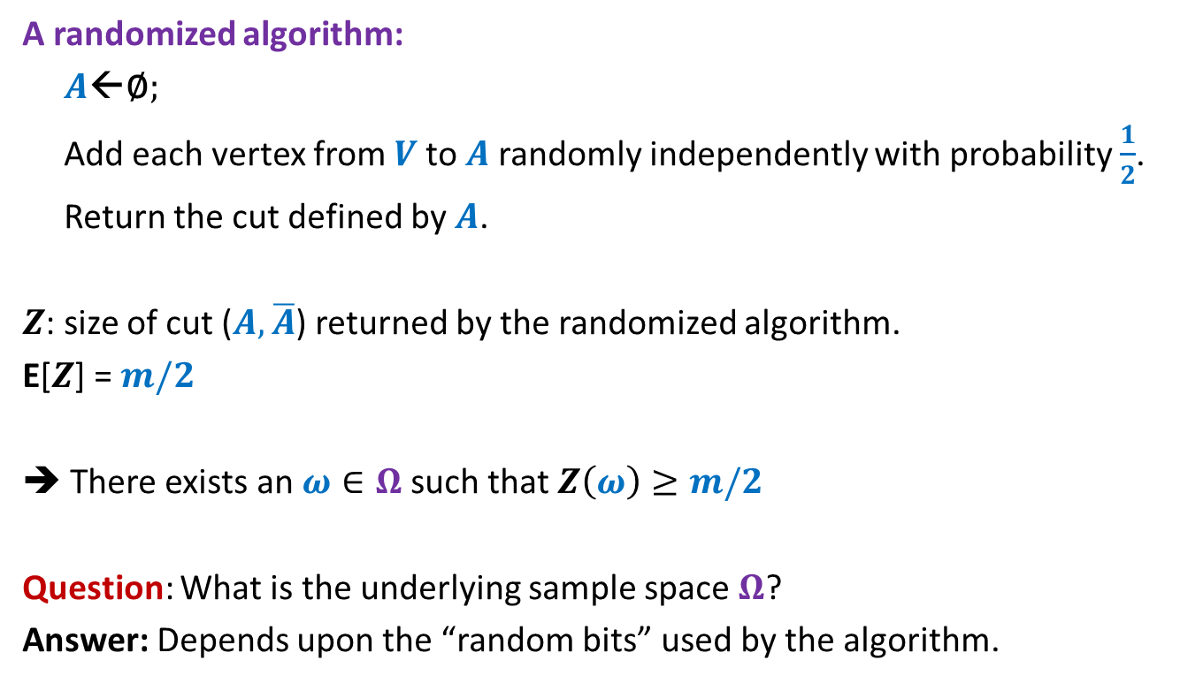
Large cut in a graph
A randomized algorithm:
$A$←∅;
Add each vertex from $V$to $A$randomly independently with probability $\frac{1}{2}$.
Return the cut defined by $A$.
$Z$: size of cut ($A,\overline{A}$) returned by the randomized algorithm.
E[$Z$] = $m/2$
➔ There exists an $ω∈Ω$ such that $Z\left(ω\right)≥m/2$
Question: What is the underlying sample space $Ω$?
Answer: Depends upon the “random bits” used by the algorithm.

Slide 26
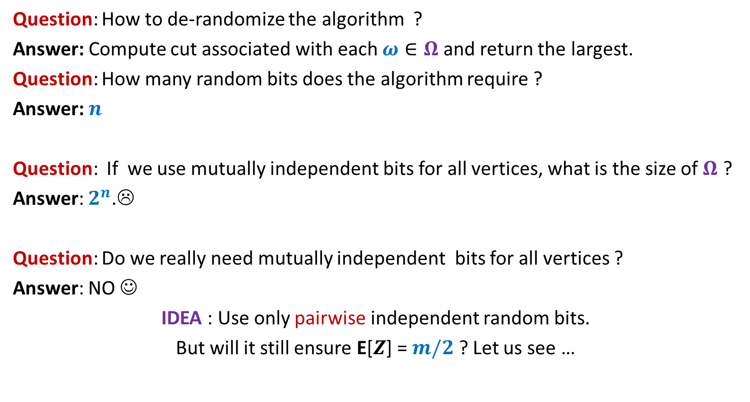
Large cut in a graph
Question: How to de-randomize the algorithm ?
Answer: Compute cut associated with each $ω∈Ω$ and return the largest.
Question: How many random bits does the algorithm require ?
Answer: $n$
Question: If we use mutually independent bits for all vertices, what is the size of $Ω$ ?
Answer: $2^{n}$.☹
Question: Do we really need mutually independent bits for all vertices ?
Answer: NO ☺
IDEA : Use only pairwise independent random bits.
But will it still ensure E[$Z$] = $m/2$ ? Let us see …

Slide 27

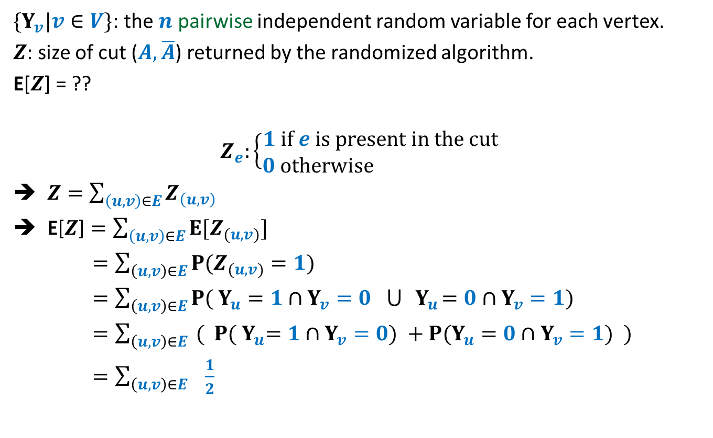


Large cut in a graph
$\{Y_{v}|v∈V\}$: the $n$ pairwise independent random variable for each vertex.
$Z$: size of cut ($A,\overline{A}$) returned by the randomized algorithm.
E[$Z$] = ??
$$Z_{e}:\left\{\begin{aligned}1 if e is present in the cut \\ 0 otherwise \end{aligned}\right.$$
$Z=\sum_{\left(u,v\right)∈E}{Z_{\left(u,v\right)}}$
E[$Z$] $=\sum_{\left(u,v\right)∈E}{{E[Z}_{(u,v)}]}$
$=\sum_{\left(u,v\right)∈E}{{P(Z}_{(u,v)}=1)}$
$=\sum_{\left(u,v\right)∈E}{{P( Y}_{u}=1{ ∩Y}_{v}=0 ⋃{ Y}_{u}=0{ ∩Y}_{v}=1)}$
$=\sum_{\left(u,v\right)∈E}{{ ( P( Y}_{u}=1{ ∩Y}_{v}=0) +{P(Y}_{u}=0{ ∩Y}_{v}=1)} )$
$=\sum_{\left(u,v\right)∈E}{ \frac{1}{2}}$
$$\frac{1}{4}$$
$$\frac{1}{4}$$
$$=\frac{m}{2}$$

Slide 28
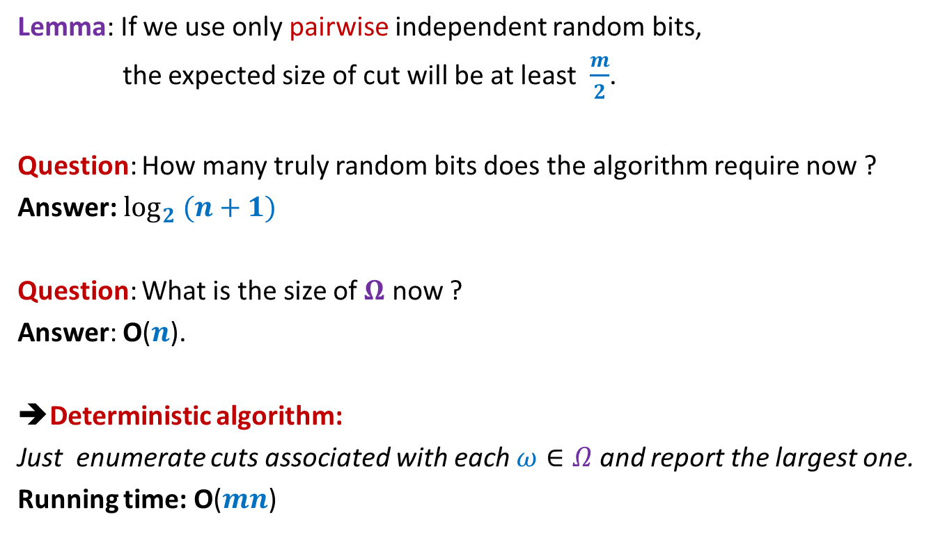
Large cut in a graph
Lemma: If we use only pairwise independent random bits,
the expected size of cut will be at least $\frac{m}{2}$.
Question: How many truly random bits does the algorithm require now ?
Answer: $\log_{2} (n+1)$
Question: What is the size of $Ω$ now ?
Answer: O($n$).
➔Deterministic algorithm:
Just enumerate cuts associated with each $ω∈Ω$ and report the largest one.
Running time: O($mn$)

Slide 29

Large cut in a graph
Theroem: There is an O($mn$) time deterministic algorithm
that computes a cut of size at least $m/2$
in a graph having $m$ edges and $n$ vertices.

